Slide 1
Berlin Museums
Coursera Capstone Applied Data Science Specialization IBM

Slide 2
Aim
This project is aimed to help tourists who come to Berlin to find the Museums near to.

Slide 3
Problem Description
In Berlin there are many museums that you can visit and each one has special features and each Museum give you new experience. When a tourists come to Berlin he/she may not be able to decide which Museum he/she should visit first, especially if the time is limited.

Slide 4
Objectives
1- the geojson data for Berlin is required.
2- Then, analyzing the data using the Foursquare API.
3- Use clustering to identify each area and its category.

Slide 5
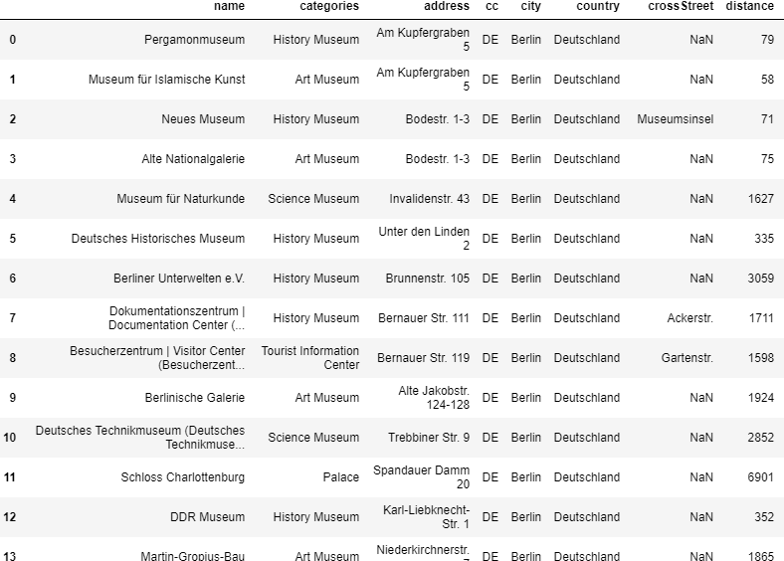
Dataset (From foursquare json)

Slide 6
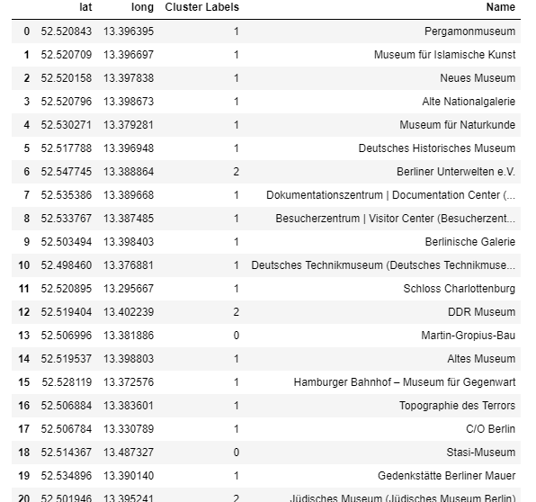
Data set processed for Clustering

Slide 7
K-Means methodology
The Κ-means clustering algorithm uses iterative refinement to produce a final result. The algorithm inputs are the number of clusters Κ and the data set. The data set is a collection of features for each data point. The algorithms starts with initial estimates for the Κ centroids, which can either be randomly generated or randomly selected from the data set.

Slide 8
Conclusion
So using Foursqaure data set I have successfully created a way to know all the location information handy, venues are easily accessible using data science methodology.

